Slide 1
SURAKSHA M

Slide 2
Violence and Non-violence video classification

Slide 3


AGENDA
Importing the required libraries
Visualize the Data
Extracting Frames
Creating the Data
Encoding and Splitting Training-Testing Sets
Importing MobileNet and Fine-Tuning it.
Building The Model
Specifying Callbacks and Fitting
Model Evaluation
Predicting the Test Set
Prediction Frame By Frame
Prediction For The Video

Slide 4

PROBLEM STATEMENT
Violence is a prevalent act happening in every part of the world that has serious consequences. Violence can wreck the physical and mental well-being of individuals and communities and is a potential threat to individual security and public safety. While surveillance cameras can monitor the security and safety of individuals, it’s a tedious task to manually check for violence in the footage. Hence, an automated violence detection system can be used to reduce human error and inefficiency, thus improving accuracy. The automated system uses CNN to detect subtle indicators of violence in real-time environments, providing privacy and security.

Slide 5

PROJECT OVERVIEW
This project for violence detection focuses on developing a system that leverages neural networks to automate the process of identifying violent events within video footage.
GOALS:
Detecting violence accurately without any error
Achieving public safety and individual security
Implementing proactive measures to prevent violence
Achieving real-time processing of videos
TECHNOLOGY USED:
The proposed model consists of a MobileNet-v2 Pretrained Model as a spatial feature extractor and Bidirectional LSTM as temporal relation learning method with a focus on the three-factor (overall generality - accuracy - fast response time). The suggested model achieved about 97% accuracy with speed of 16 frames/sec.

Slide 6
PROJECT OVERVIEW
REQUIREMENTS:
Hardware requirements:
A multicore CPU
An 8 GB RAM
A reliable internet connection
Software requirements:
Python is used to implement the code
Google colab or Jupyter notebook used for interactive development of the project
TensorFlow, NumPy, Matplotlib

Slide 7
WHO ARE THE END USERS?
Law Enforcement Agencies: Police departments and law enforcement agencies use these systems to monitor public spaces, identify potential threats, and respond to violent incidents.
Security Personnel: Security personnel in various settings such as airports, train stations, shopping malls, utilize violence detection systems to enhance security measures, prevent criminal activities, and ensure public safety.
Schools and Educational Institutions: Schools and educational institutions may deploy violence detection systems to monitor campus activities, detect bullying or physical altercations.
Workplaces: Employers and businesses may implement violence detection systems in workplaces to prevent workplace violence and maintain a safe and secure work environment.
Public Transportation Authorities: Public transportation authorities, including bus and train operators, may use violence detection systems to ensure passenger safety, prevent crimes, and address security concerns on public transit systems.
Social Media Platforms: Social media companies may deploy violence detection systems to monitor user-generated content, identify and remove violent or harmful content, and enforce community guidelines to maintain a safe and healthy online environment.
Individuals and Families: Individuals and families may also use violence detection systems for personal security purposes, such as monitoring home security cameras or installing mobile apps that detect and report violent incidents in their vicinity.

Slide 8

YOUR SOLUTION AND ITS VALUE PROPOSITION
CNN (Convolutional neural network) followed by LSTM (Long-short term memory) has been proved to be the best architecture when data are small and low computing power available for the task in hand.
The proposed solution consists of a MobileNet-v2 pretrained Model as a spatial feature extractor and Bidirectional LSTM as temporal relation learning method with a focus on the three-factor (overall generality - accuracy - fast response time). The suggested model achieved about 97% accuracy with speed of 16 frames/sec.
The system works by breaking down the video into frames. We feed each frame to MobileNet-v2 which is a Convolutional Neural Network to extract the information in the video.
Then a bidirectional LSTM layer is used to compare the current frame with the previous frame. Finally, the classifier is used to identify whether an action is violent or not.

Slide 9

THE WOW IN YOUR SOLUTION
The “wow” factor in my solution is that I have implemented violence detection system in a mobile network which is mobilenet-v2. This can be used in a mobile application.
9

Slide 10
MODELLING
Importing libraries:
We first start by importing the necessary libraries such as NumPy, TensorFlow, Matplotlib, and Keras
Extracting frames:
For video classification, the video is split into several frames and then the interval after which frames will be added to the list is calculated
Training and Testing test:
The dataset is split into training and testing. 90% of the data is given to training and 10% is given to testing.
Importing MobileNet and Fine-Tuning it:
MobileNet-v2 is imported to implement the model and Fine-Tuning is used to make the last 40 layer trainable.
Building the model:
The model is build using frames extracted and activation function used to build it.
10

Slide 11
MODELLING
Model evaluation:
The model is evaluated by getting the epochs count.
Model Testing:
The model is tested using the test data and then the classifier predicts whether its violent or not.
11

Slide 12
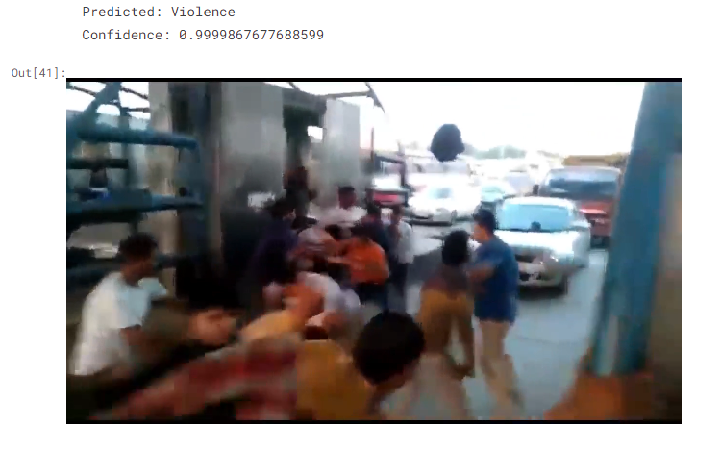
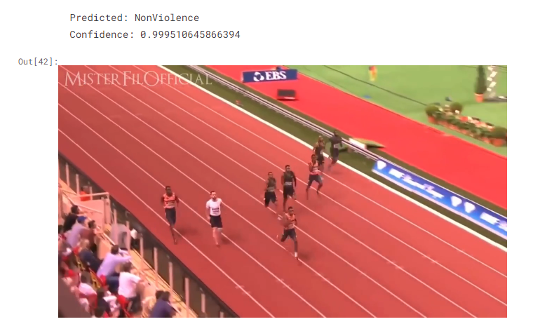
RESULTS
Our proposed MobileNetV2-BiLSTM variant provides the reportedly best results for the used dataset. The screenshot of the results are shown below:
12

Slide 13
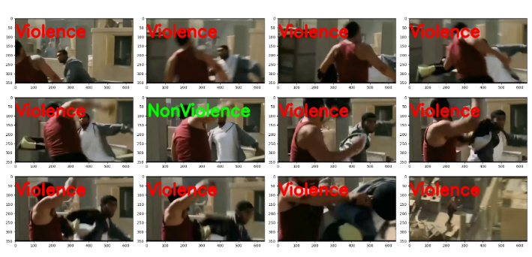
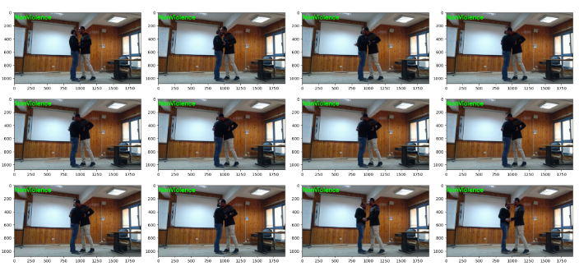
RESULTS
Frame by frame prediction:
13

